Slide 1
Lāʻieikawai In Mele
developed by Hannah Spencer

Slide 2
Haʻina ʻia mai ana ka puana
“Let the echo of our song be heard”

Slide 3
Songs, chants, and poems
“While songs, chants, and poems are considered separate genres in Anglo-American literary traditions, in Hawaiian literary traditions they often overlap; the primary distinctions among them come from the mode of performance: a song is sung, a chant is chanted, a poem is recited” (hoʻomanawanui 30).

Slide 4
Poetic Devices
“Metaphor, imagery, and kaona are so important in Kanaka Maoli poetry that, for poets and critics alike, they often supercede all other elements” (hoʻomanawanui 31-2).

Slide 5
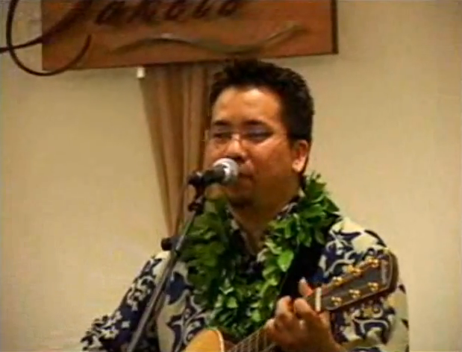
“Lāʻieikawai”
http://www.youtube.com/watch?v=EMVpPrvWZ4U

Slide 6
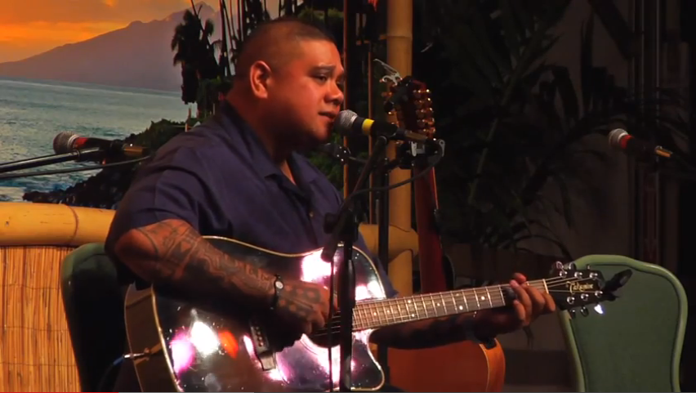
“Ka Pilina”
http://www.youtube.com/watch?v=ZLKDt5rDMqE

Slide 7
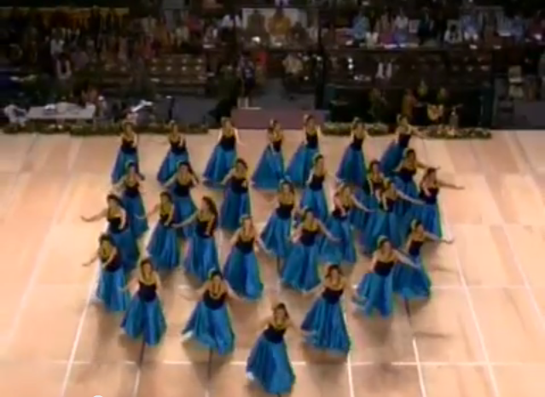
Hula
http://www.youtube.com/watch?v=tmymdeQ-R-8

Slide 8
Activity
Take the time to read over the lyrics to the two mele again.
Then, complete the compare and contrast matrix on your handout.
Focus on the 2nd and 3rd columns first, and then compare the mele to the book.

Slide 9
Activity
Think about what you might include in a mele about Lāʻieikawai and list three things.
Share with a classmate what you would include.
Star any of the details about Lāʻieikawai you had in common.

