Slide 1
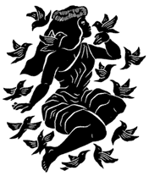
Lāʻieikawai
Cultural Context & History
developed by Hannah Spencer

Slide 2
Notes:
ʻŌʻo (black honey-eaters) in a ʻōhiʻa lehua tree. Read the inside cover note about the cover art (page vi).

Slide 3
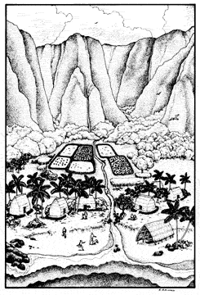
“Hawaiians have long looked to the stories of their ancestors' lives for direction in their own lives” (Kuwada 54).
Notes:
Read the foreword by Author S.N. Haleʻole.

Slide 4
Lāʻieikawai
First book published by a Hawaiian author in Hawaiian
Book for “reading pleasure”
Story of a well-known aliʻi, Lāʻieikawai
Written to “prevent the loss of [Hawaiʻi’s] fascinating traditions”

Slide 5
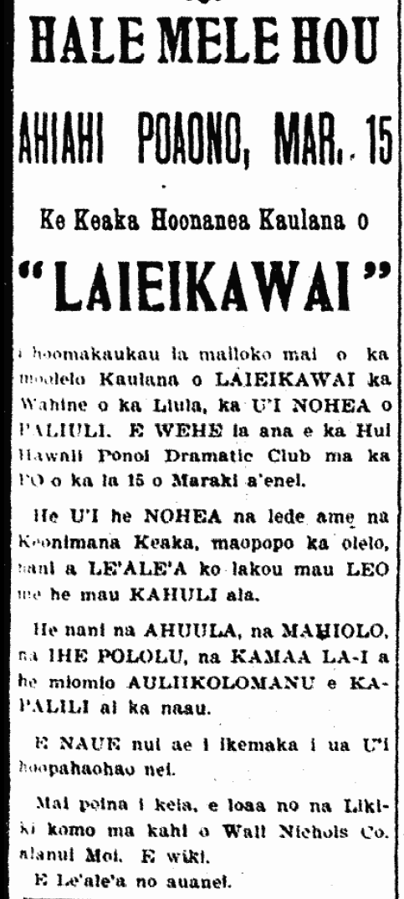
Translation
Notes:
Read the Introduction by the Translator, Martha Warren Beckwith (pages ix-x). Note how many hands went into the translation of this one text.
Read the Editorial Notes (xi).

Slide 6
Translation
The knowledge of “[a]t least 100,000 pages of Hawaiian-language newspapers of the nineteenth and early-twentieth centuries… remains locked away from the 95 percent of Hawaiians who cannot speak Hawaiian, because only a tiny fraction has been translated into English” (Kuwada 55).
So why not translate?
Notes:
Talk about the pros and cons of translation.

Slide 7
Issues with Translation
“English versions of Hawaiian writings have created and perpetuated gross misrepresentations of the lives and culture of the Hawaiian people. A range of problematic and even unethical practices—many not even involving the translating itself—took the translations further and further away from the source texts” (Kuwada 55).

Slide 8
Activity: Research
Find a partner. Decide on and sign up for one of the topics about the cultural context of Lāʻieikawai.
Together, prepare a 2-3 minute presentation about your topic to present to the class.
Include why this topic is significant.
Create some sort of mnemonic device (memory tool) to help the class remember the information from your presentation.

Slide 9
Topics
ʻŌlelo Noʻeau
Ancient Hawaiian Social Structure
Children (#2)
The Hawaiian year (#7)
Paliulu (#13)
Mokomoko (#14)
Hawaiian lunar month (#16)
ʻŌʻo (#17)
Kōnane (#23)
Maile (#28)
Pū lāʻī (#31)
Kilu and ʻume (#35)
Punalua (#37)
Relationship between Hawaiʻi and Kahiki (#48)
Hānai relationships
Kapu
Moeʻuhane
Clothing
Notes:
ALSO SEE CULTURAL KNOWLEDGE PAGE on LaieikawaiInTheClassroom.weebly.com for a full list of possibilities.

